Slide 1
Idle CofE Year 6 Parent Information Evening

Slide 2
Overview
At the end of key stage 2 (KS2), pupils take national curriculum tests in:
English grammar, punctuation and spelling
English reading
mathematics

Slide 3
SATs
With the introduction of the new Primary National Curriculum in 2014, the Government abolished National Curriculum levels (Level 3a, 3b, 3c, 4a, etc).
Children are now given a scaled score for their SATs. With the scaled score, there is a national age related expectation.
There are high expectations for all children to reach the expected standard.

Slide 4
What is a scaled score?
Each pupil will be given a raw mark (the number of marks they get on a test) which is then converted into a scaled score using a conversion table.
A scaled score of '100' or more means that a child is working at the national standard for a child of their age.
A scaled score of ‘110’ or more means that a child is working at greater depth against the national standard for a child of their age.

Slide 5
2017 scaled score conversion tables compared with 2018

Slide 7
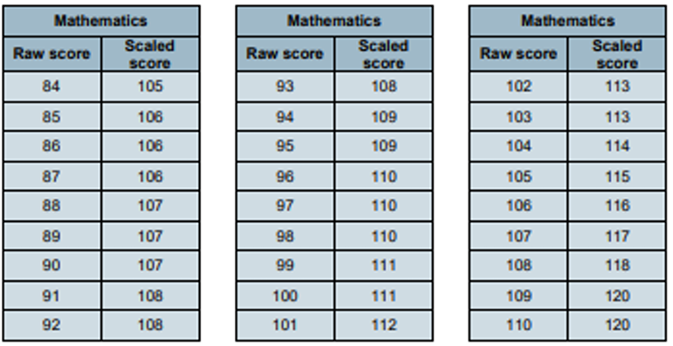

Slide 9
What does it all mean?
On publication of the test results:
A child awarded a scaled score of 100 is judged to have met the ‘national standard’ in the area judged by the test and is said to be ‘working at the expected standard’.
A child awarded a scaled score of less than 100 is judged to have not yet met the national standard and is said to be ‘working towards the expected standard.’
A child awarded a scaled score of 110 or more is judged to have exceeded the national standard, demonstrating a higher than expected knowledge of the curriculum for their age, and is said to be ‘working at greater depth against the expected standard.’

Slide 10
SATs week 2025
Additional arrangements will be made for the start of the day for Year 6.
Please ensure there are no absences
during this week.
Additional arrangements will be made for the start of the day for Year 6.
Please ensure there are no absences
during this week.

Slide 11
Spelling, Grammar and Punctuation
15 minute Spelling test based upon words learnt throughout Key Stage 2.
45 minute spelling, punctuation and grammar test involving short answer or simple explanation questions.
Marks from both test are added together. The spelling test alone is worth 20 marks.

Slide 13
Reading
60 minutes.
3 unrelated texts and 1 answer booklet.
The questions are designed to assess the understanding of a child's reading through a variety of comprehension questions. Questions test children’s ability to retrieve and infer, to summarise and predict and their understanding of the author’s language choices.
The wording of the questions can be confusing.
Some questions are multiple choice or selected response, others require short answers and some require an extended response or explanation.

Slide 16
Mathematics
The children will sit three tests (Paper 1, 2 and 3).
Paper 1 (Arithmetic) 30 minutes. 36 questions that test calculation methods for all operations (+ - x ÷), including fractions, percentages and decimals. This alone is worth 40 marks.
Questions increase in difficulty as the children progress through it.
Paper 2 and 3 (Reasoning and Problem Solving) 40 minutes. Tests the application of calculation methods and other areas of the maths curriculum such as shape, measure, geometry and statistics.
Pupils must read each question carefully and there may be several steps involved in order to find a final answer.

Slide 19
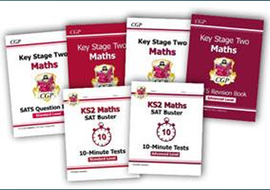
How will we help?
High expectations at all times
Children are organised into specific groups across the year group for Reading and Maths with additional teachers available for targeted support.
Regular test practice.
Weekly homework.
Spelling, punctuation and grammar is taught within English lessons and as standalone revision sessions.
Regular drip feeding of SAts specific content through out the school day.
CPG revision books available.
High expectations at all times

Slide 20
How can you help?
First and foremost, support and reassure your child that there is nothing to worry about and that all we can ask for is them to try their best. Praise and encouragement works wonders!
Ensure your child has the best possible attendance at school.
Support your child with any homework tasks.
Regular spelling and arithmetic (e.g. times tables) practise will be useful.
Listen to your child read regularly and discuss what they are reading with them.
Talk to your child about what they have learnt at school.
Make sure your child has plenty sleep and a healthy breakfast each morning.

Slide 21
Changes

Slide 22
Changes
All children have a puberty talk in Year 6 which tops up the introduction given to them
from the puberty talk in Year 5.
Female member of staff for girls: using the NHS guidance talked about the changes that
happen to girls and how body parts develop. Also spoke about personal hygiene.
Male member of staff for boys: using the NHS guidance talked about the changes that
happen to boys and girls and how boys’ body parts develop. Looked also at personal
hygiene.
The children will also have support to deal with their emotions during their time in Year 6 – we will support them with worries about SATs and leaving primary school.
Personality changes – it is normal to see changes in your child’s personality as the year progresses. The Year 6 team are on hand to support your child through this process.

Slide 23
Transition to Secondary School

Slide 24
Growing up
Transition to secondary school can be a worrying time for children:
They are moving away from their safety net at Primary School
They may be moving to a school different to all of their friends
Secondary schools are much bigger
Children will have a different teacher for each subject
Children are required to become more independent.
Don’t worry - most children cope with these and feel
accustomed to the changes by the end of the first
couple of weeks.

Slide 25
When and how does transition happen?
Families will find out which secondary school their child has been offered a place at– you will need to accept this or appeal if unhappy with the allocation offer.
Once the children have taken their SATs in May, members of staff from secondary schools will begin to come to Idle to meet the children prior to their transition day.
Wednesday 2nd July all children attending secondary schools in Bradford have their transition day.
Children who we feel need extra support during transition will have additional sessions at their school before and after this date.
Children attending Leeds Secondary Schools will have a different transition day.

Slide 26
Who is there to help?
Within school, Mrs Russell and Mr Ejraee and Mr Gamesby co-ordinate the transition process; liaising with schools and supporting children.
Secondary schools will run a parents evening around the time of transition where key information will be shared.
During our curriculum time after the SATs, we will ensure time is dedicated to preparing the children for their transition to secondary school.

Slide 27
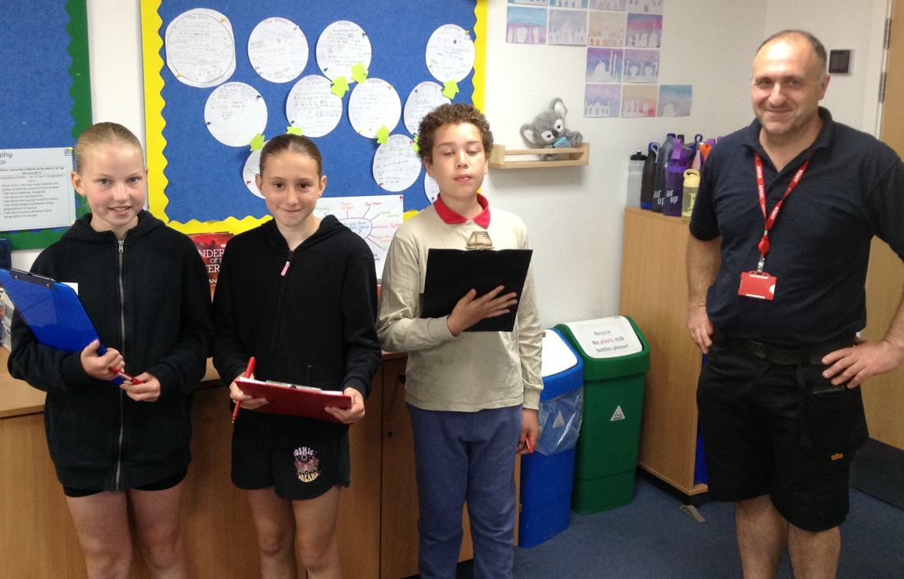
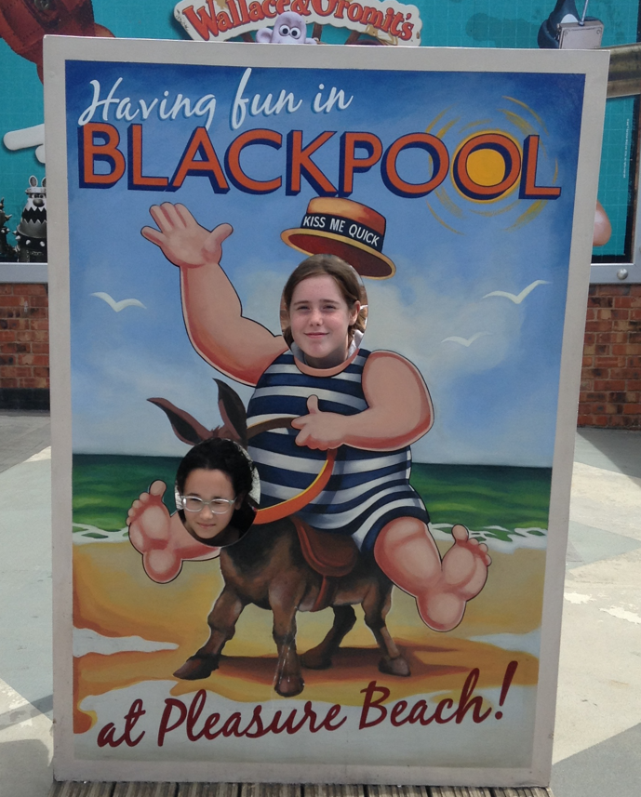
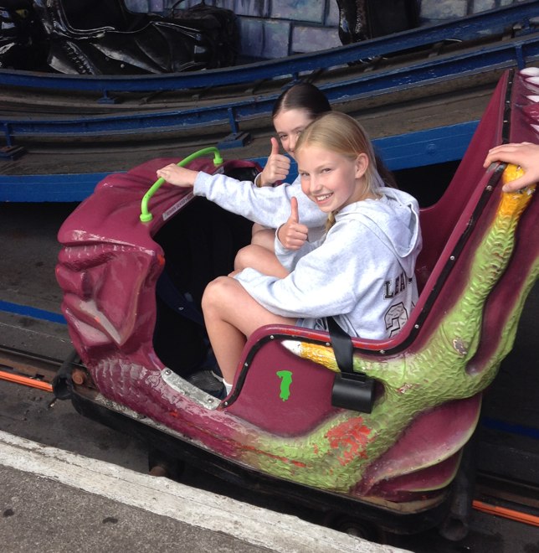
Making memories
This year Year 6 will be:
Visiting Blackpool
Doing School take over day
Countryside day at Harewood house.

Slide 28
Thank you for listening.
Questions?

