Slide 1
Spelling at Idle C of E

Slide 2
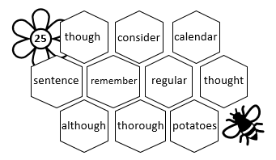
Spelling
Why have we changed our spelling scheme?
Spellings are taken from the statutory lists provided by the government.
Spellings reflect words used in children’s writing, making them a useful addition to our writing toolkit.
Spellings are tailored to the individual needs of the children.
Spellings support reading and writing fluency.
When learnt effectively, spellings allow children to concentrate on writing composition, so improving writing.
Good spelling is a skill for life!
Explicit spelling rules will be taught in the classroom but do not require children to learn words.

Slide 3
Spelling
What does our spelling bee involve?
Children have a week to learn spellings at home.
Children are tested weekly in class.
Ten spellings must be correct to move to the next honeycomb.
Occasionally, children may be given a ‘randoms’ test.
Every effort will be made to ensure children progress and are successful in their spelling.
Children will be tested at the beginning of every year to ensure spellings are embedded.

Slide 4
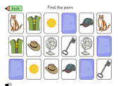
Spelling
How can we make learning spellings fun?
Pelmanism/pairs – write all the spellings on small cards/paper twice. Turn them face down – can you find matching pairs?
Rainbow words – use coloured pencils/gel pens to write words out in rainbow colours.
Triangle/Pyramid words - Write the words in the shape of a triangle by writing the first letter then writing the first and the next letter underneath, then the first, second and next letter underneath that until you have used all the letters. For a pyramid, take one letter away each row from the middle.

Slide 5
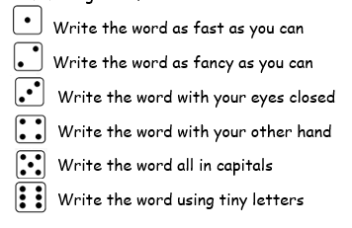
Spelling
How can we make learning spellings fun?
Roll and Spell - Roll a dice and write a chosen spelling word in the style that is indicated. Change it up with new writing ideas!
Words on a computer - Type the words out on a computer. Change the font, size, colour, use word art etc.
Hang man - Choose a spelling word and use it as your hangman word!

Slide 6
Questions or feedback

